Slide 1
Ramifications of COVID-19 on Consumers, Markets,
and the Pursuit of Clean Energy
David Kolata, Executive Director
Citizens Utility Board
November 18, 2020

Slide 2
The Illinois Response to Covid-19
Strong consumer protections through at least end of year
Disconnection moratorium (with *)
Extended DPAs – up to 24 months
Low income & hardship customer bill payment assistance
Waiver of deposit requirements
Waiver of credit reporting and collection activities
Reconnections without fees upon request of customers disconnected pre-Covid (unless theft, safety hazard)
Customers can self-certify financial hardship
Monthly reporting of credit/collections data by zip code

Slide 3
Consumers Struggling to Pay Utility Bills
Percentage of Customers with Late Fees in September:
Peoples Gas – 30% (!)
Ameren – 20%
Nicor Gas – 19%
ComEd – 18%
Average amount in arrears nearly doubled

Slide 4
Covid-19 as a Great Accelerator
Increasing inequality
Further exposing harm from air pollution
Highlighting environmental injustice
Accelerating economic/political collapse of PGL pipeline replacement program
Need Affordable, Equitable Transition to 100% Clean Energy

Slide 5
Transition to 100% Clean Energy Requires (at a minimum):
Increased bill assistance for LMI consumers
Prioritizing environmental justice communities
More equitable rate design (driven by data)
Realigning utility incentives around maximizing consumer/enviro value
RTOs supporting and facilitating least-cost decarbonization
Repurposing dollars currently spent on dirty energy
Focus on political economy and the art of the possible
Comprehensive, Consumer-friendly Approach that Solves for Climate Change

Slide 6
Six Unique Load Shapes Cluster Analysis
Matched Summer Residential Usage Patterns to Demographic Profiles
K-means clustering algorithm
2017 American Community Survey block data
Determined likelihood of cluster member to live in an area with particular attributes
Flatter load shapes associated with lower income and urban areas
Peakier load shapes associated with higher income, suburban, and rural areas
The Electricity Journal 32 (2019) 106643 – bigenergydata.info

Slide 7
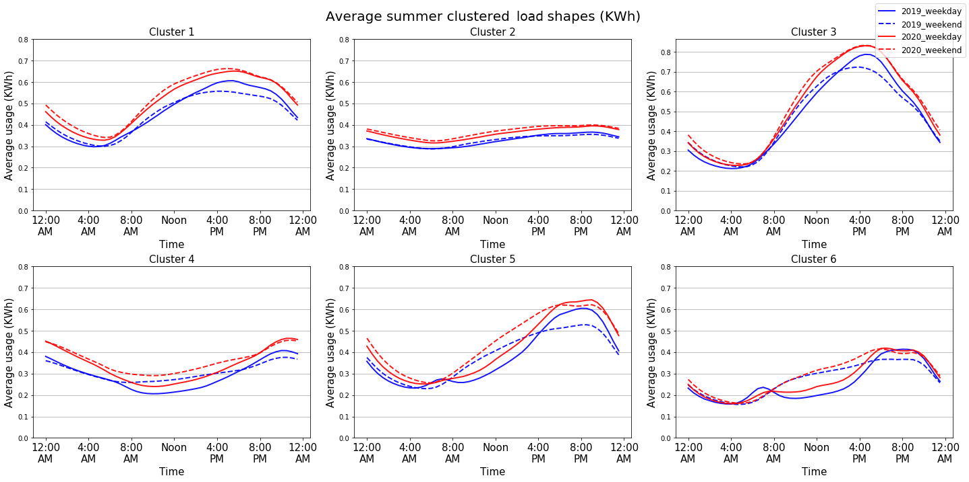
Impact of Covid-19 on ComEd Residential Average Summer Load Shape

Slide 8
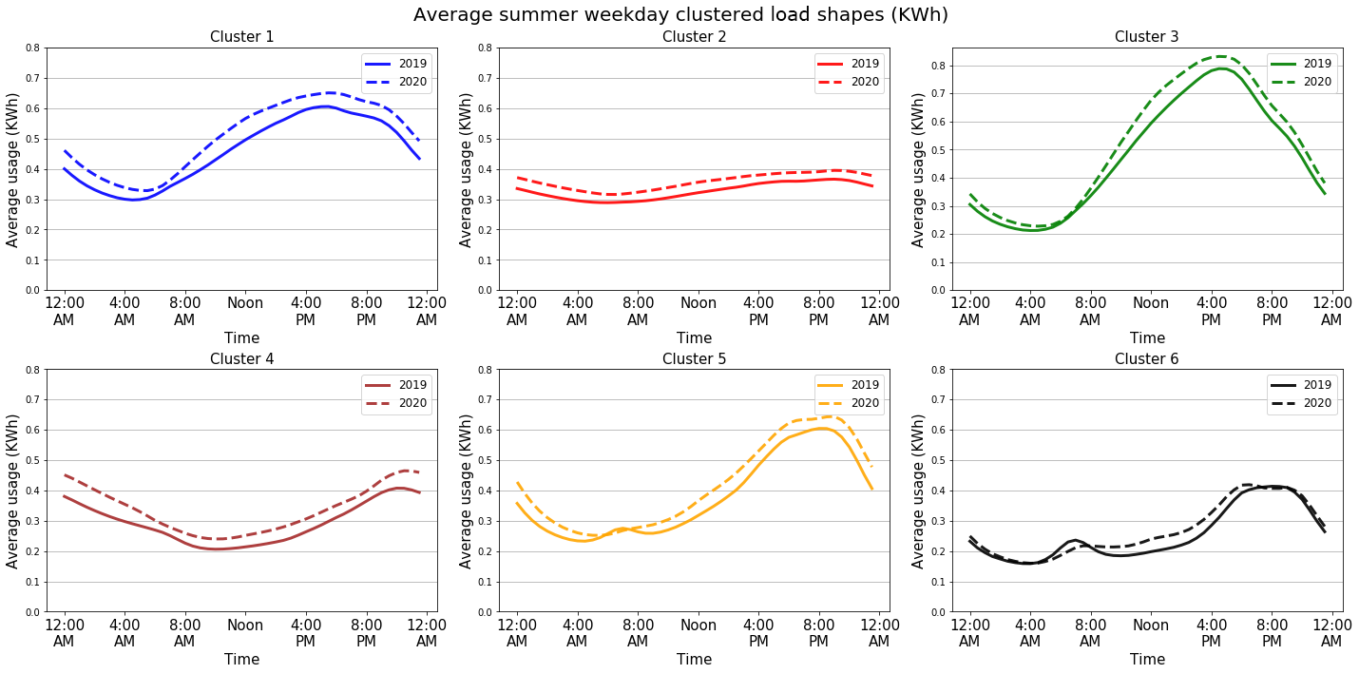
Impact of Covid-19 on ComEd Average Summer Weekday Load Shape

Slide 9
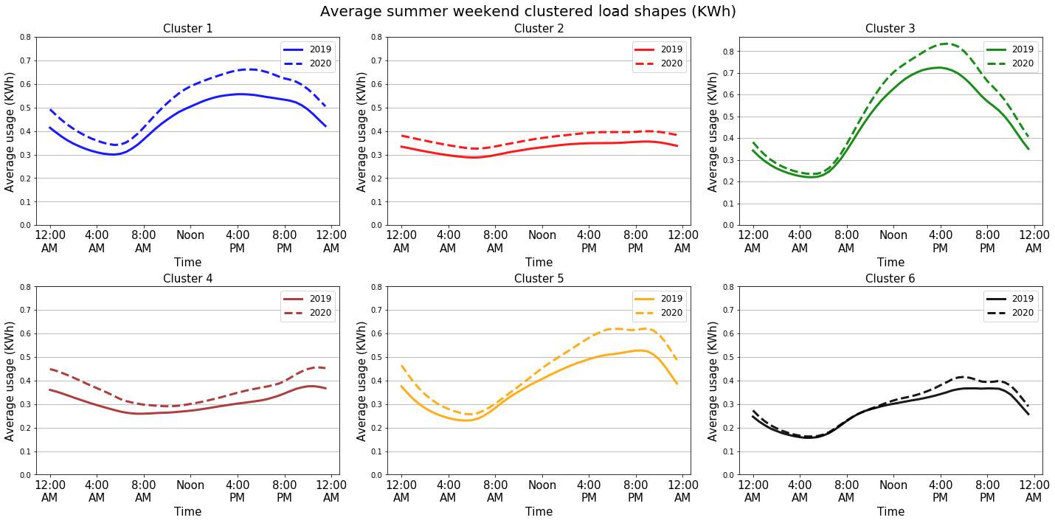
Impact of Covid-19 on ComEd Average Summer Weekend Load Shape

